Slide 1
GCBASIC
PIC18FxxQ24
Part 14 - PMW many ways

Slide 2

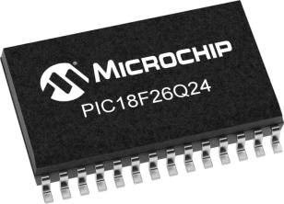
GCBASIC
PIC18FxxQ24
Part 14 - PMW many ways

Slide 3
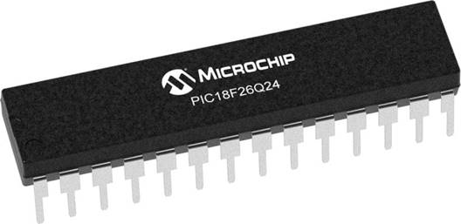
GCBASIC
Like and subscribe!

Slide 4
PIC18FxxQ24
PIC18-Q24 is a high performance PIC18
Digital and Analog peripherals
10-bit ADC
Multiple communication interfaces
Serial, I2C and SPI
PWM – CCP/PWM and 16Bit
Configurable Logic Cells
Multi voltage domains
The PIC18xxQ24 offers 28, 40 and 48-pin products in small footprint packages to support customers in a wide variety of applications.

Slide 5
Videos...
Install the hardware and make the board work – three LED programs
Make four LEDs flash in a sequence
Set the LEDs to represent the value of ADC
Sequence the LEDs with a delay using the value of ADC
Using an input to set the state of the LEDs
Using the reset switch
Using the switch, ADC – make the LEDs flash in a sequence with reverse
Using the serial to display values
Using the timer0 overflow, 8bit timer, 16bit timer to flash the LEDs
Using EEProm – showing values on the serial terminal, and more constants insights
Using I2C with serial to discover I2C devices
Using I2C GCLD display solutions
Using a SPI GLCD display solutions
Using PWM, 6 ways, to dim the LEDS
Using an external interrupt to control an LED
Using storage within the chip – Progmem, SAF memory, EEPROM and DATA blocks
Using CLC
The GCBASIC tool chain
Assembly , alternatives assemblers and MPLAB-X
Summary

Slide 6
GCBASIC Compiler
GCBASIC Compiler
GCBASIC is an Open Source compiler for PIC and AVR microcontrollers
GCBASIC now supports the 18FxxQ24 chip family

Slide 7
Prerequisites
Assumes you have
Installed the GCBASIC software
Installed your programmer software
Test that you have the 18FxxQ24 attached
You have the 4 LEDs operating
You have a POT connected
You have SWITCHes connected
You have a USB/TTL converter

Slide 8
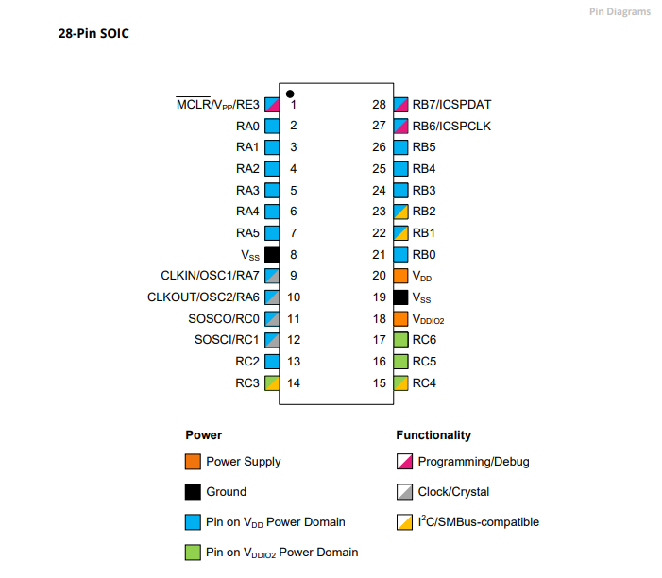
Power Domain – VDDIO2

Slide 9
Hardware
Hardware
-------------------PORTA----------------
Bit#: -7---6---5---4---3---2---1---0---
IO: ----------------SW----------ADC--
----------------------------------------
-------------------PORTB----------------
Bit#: -7---6---5---4---3---2---1---0---
IO: ----------------LED-LED-LED-LED--
----------------------------------------
------------------PORTC-----------------
Bit#: -X---6---5---4---3---2---1---0---
IO: -^--TX---------------------------
-----VDDIO2-----------------------------
You must apply correct Voltage
------------------PORTE-----------------
Bit#: -----------------3---------------
IO: ----------------SW---------------
Prototype Board
Power 5v0
Programmer
LEDs & resistors
Switches & resistors
SPI device and circuit

Slide 11
Pulse Width Modulation
Pulse Width Modulation ( PWM ) is simply a succession of pulses – is a method of reducing the average power delivered by an electrical signal, by effectively chopping it up into discrete parts.
The average value of voltage (and current) fed to the load is controlled by turning on and off at a fast rate. The longer the signal is on compared to the off periods, the higher the total power supplied to the load.

Slide 12
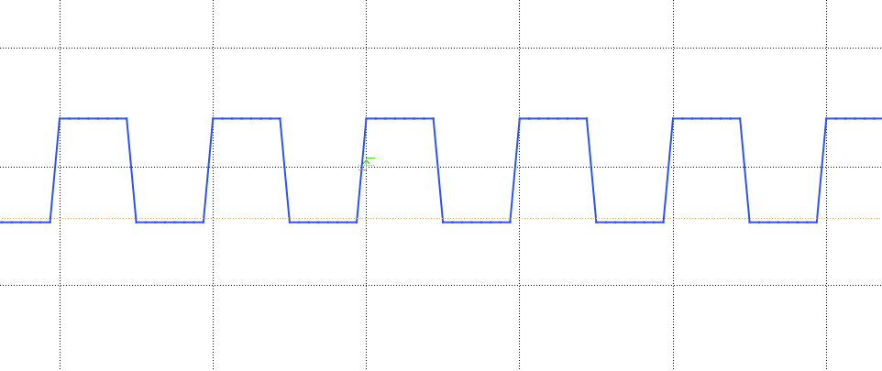
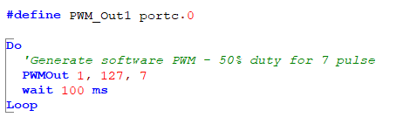
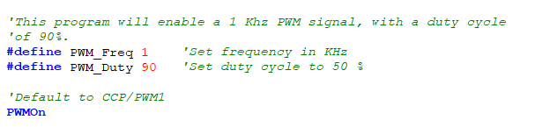
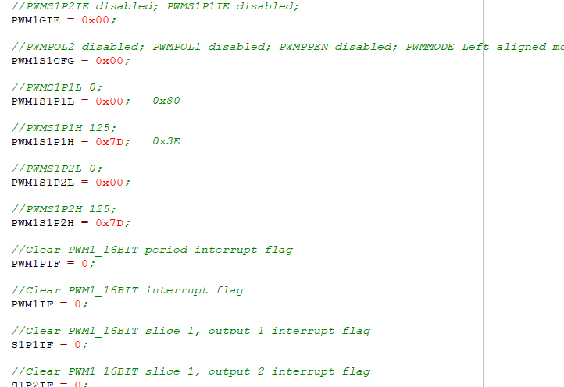
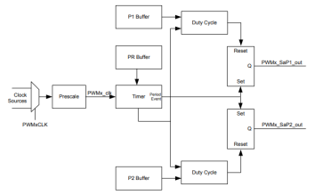
PWM

Slide 13
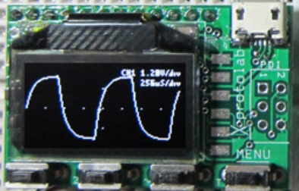
Setup
http://www.gabotronics.com/development-boards/xmega-xminilab.htm

Slide 14
PWM
 | PWM type | Characteristics | PPS required | Comment
1 | The simplest way | Port on and off | No | Any port**
2 | The pulseout() way | PulseOut() a port for a period | No | Any port**
3 | The PWMOut() way | PWMOUT() a number of pulses | No | Any port**
4 | CCP/PWM way | Fixed frequency, fixed duty using timer2* | Yes – CCP/PWMx module | Low code impact, two constants
5 | CCP/PWM way | Variable frequency, variable duty using timer2* | Yes – CCP/PWMx module | ASM does the heavy lifting
6 | PWM 16 bit way | Wide range of capabilities | Yes - PWMxx | Lots of parameters
7 | Timer interrupt way | Use a timer1* | No | Any port**
* could use other timers
** any valid output

Slide 15
Lab
Walk the examples
View the scope

Slide 17
Videos...
Install the hardware and make the board work – three LED programs
Make four LEDs flash in a sequence
Set the LEDs to represent the value of ADC
Sequence the LEDs with a delay using the value of ADC
Using an input to set the state of the LEDs
Using the reset switch
Using the switch, ADC – make the LEDs flash in a sequence with reverse
Using the serial to display values
Using the timer0 overflow, 8bit timer, 16bit timer to flash the LEDs
Using EEProm – showing values on the serial terminal, and more constants insights
Using I2C with serial to discover I2C devices
Using I2C GCLD display solutions
Using a SPI GLCD display solutions
Using PWM, 6 ways, to dim the LEDS
Using an external interrupt to control an LED
Using storage within the chip – Progmem, SAF memory, EEPROM and DATA blocks
Using CLC
The GCBASIC tool chain
Assembly , alternatives assemblers and MPLAB-X
Summary

Slide 18
GCBASIC
PIC18FxxQ24
Part 14 - PMW many ways

